Slide 1
Digital Portfolio
STUDENT NAME: V.Sri Sabari Anand
REGISTER NO AND NMID: 2428A0006 & asbru312428a0006
DEPARTMENT: B.Sc DCFS
COLLEGE: Cheran Arts Science College

Slide 2
PROJECT TITLE
💧Daily Water Intake Tracker

Slide 3


AGENDA
Problem Statement
Project Overview
End Users
Tools and Technologies
Portfolio design and Layout
Features and Functionality
Results and Screenshots
Conclusion
Github Link
3/21/2024 Annual Review

Slide 4

PROBLEM STATEMENT
🎯 Problem Statement
Many people forget to drink enough water throughout the day, especially during work or study. This app solves that by:
Providing a clear hydration goal
Tracking intake in real time
Offering automatic and manual reset options
Delivering motivational feedback

Slide 5

PROJECT OVERVIEW
The Daily Water Intake Tracker is a lightweight wellness tool built with HTML, CSS, and JavaScript. It allows users to log their water consumption, track progress toward a daily goal, and reset their stats each day. Designed with a clean, mobile-friendly interface, it encourages healthy habits through simple interaction and visual feedback.

Slide 6

WHO ARE THE END USERS?
1. Health-Conscious Individuals
2. Office Workers & Students
3. Fitness Enthusiasts & Athletes
4. Elderly Users or Caregivers
5. Remote Workers & Freelancers

Slide 7

TOOLS AND TECHNIQUES
Technology | Purpose
HTML5 | Structure and layout
CSS3 | Styling and responsive design
JavaScript | Logic and interactivity

Slide 8
POTFOLIO DESIGN AND LAYOUT
🧠Portfolio Design Goals:
✅ Clean and modern aesthetic
📱 Mobile-responsive layout
🎯 Clear project purpose and features
📸 Visuals to engage viewers
🔗 Easy navigation to code/demo
‹#›

Slide 9
FEATURES AND FUNCTIONALITY
Features are what the product offers—like login, dashboard, or notifications.
Functionality is how those features work—like validation, syncing, or automation.
Features are user-facing; functionality is behind-the-scenes logic.
Together, they define the user experience and system performance.

Slide 10
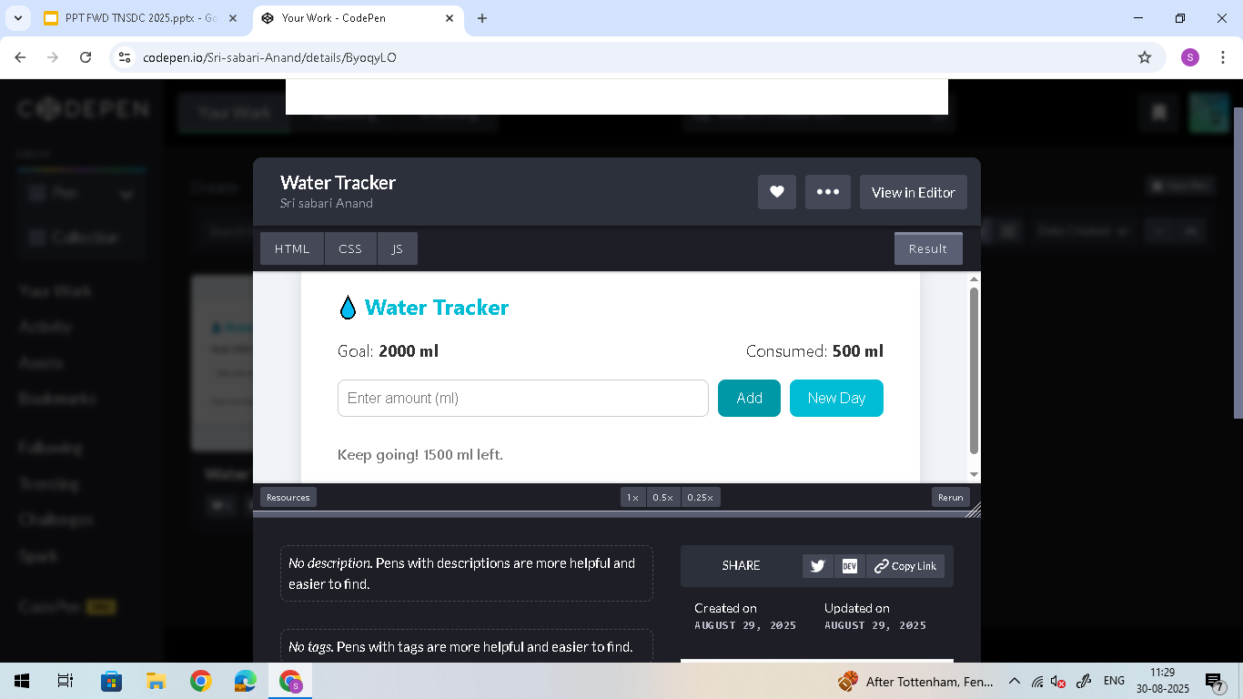

RESULTS AND SCREENSHOTS
3/21/2024 Annual Review
‹#›

Slide 11
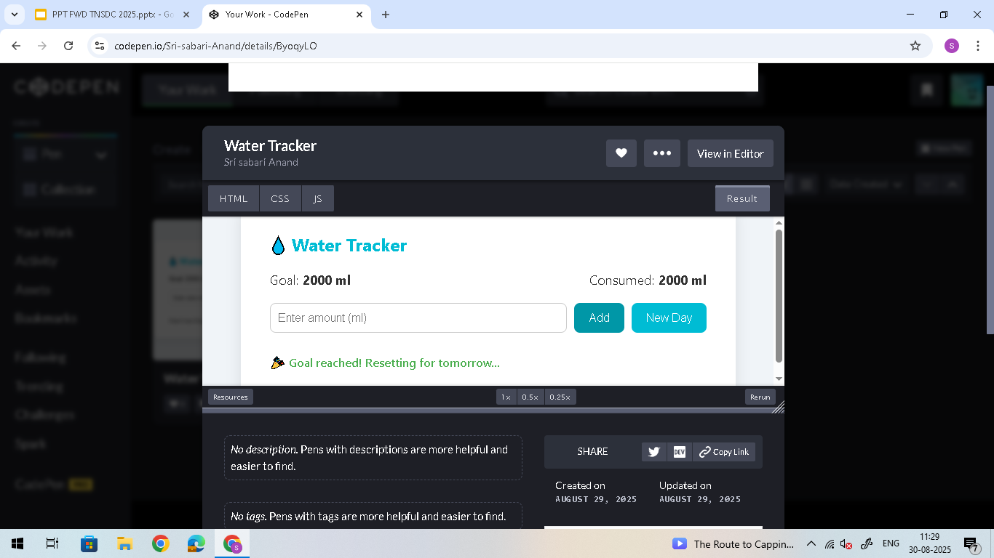
RESULTS AND SCREENSHOTS
3/21/2024 Annual Review
‹#›

Slide 12
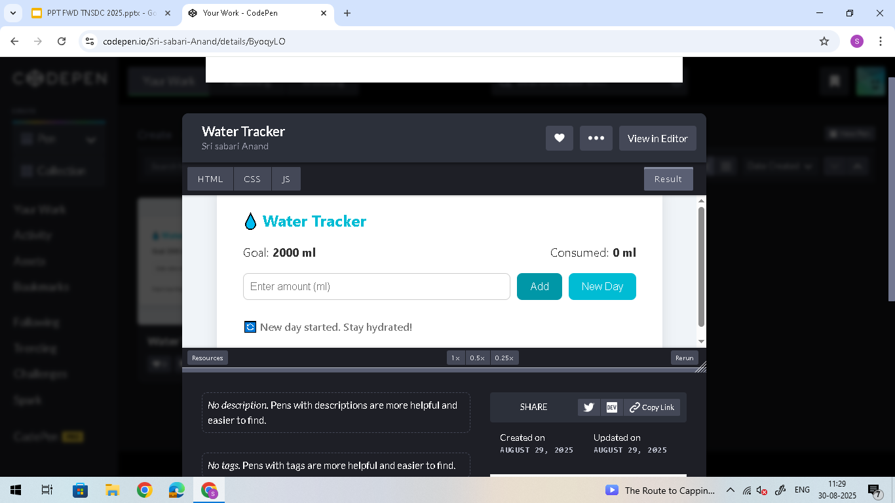
RESULTS AND SCREENSHOTS
3/21/2024 Annual Review
‹#›

Slide 13
CONCLUSION
The Daily Water Intake Tracker is a simple yet powerful tool designed to promote healthier habits through consistent hydration. By combining intuitive design, responsive layout, and real-time feedback, the app empowers users to take control of their daily water goals with ease.
Whether you're a fitness enthusiast, a busy professional, or someone just trying to drink more water, this tracker offers a seamless experience that fits into any lifestyle. It’s not just about logging ounces—it’s about building a habit that supports long-term wellness.
‹#›

